Slide 1
PROJECT
HILOANPREDICT: OPTIMIZED ENSEMBLE FRAMEWORK FOR INTELLIGENT LOAN ASSESSMENT

Slide 2
ABSTRACT
Loan approval prediction system that leverages multiple ensemble methods and gradient boosting algorithms using a hill climbing optimization approach. The framework includes CatBoost, XGBoost, LightGBM, and Gradient Boosting Classifier, analyzing eleven key features like age, income, property status, and credit history. Enhanced by Optuna for hyperparameter optimization.
Predict loan approval probabilities using gradient boosting and logistic regression models, incorporating advanced feature engineering techniques

Slide 3
introduction
The evolution of financial technology (fintech) has reshaped the financial services industry, particularly in loan evaluation and processing. Traditional manual methods are hindered by biases, inefficiencies, and scalability issues. Machine learning (ML), a branch of artificial intelligence, offers consistent, fast, and scalable solutions by analyzing vast data and detecting subtle patterns. This paper develops a loan approval prediction system using ensemble methods and gradient boosting algorithms, providing a comprehensive risk profile by considering various factors like employment history and spending habits. Ensemble learning combines multiple models, enhancing accuracy and reducing bias in decision-making.

Slide 4
PROBLEM STATEMENT
Efficiencies in Traditional Loan Approval Processes:
Cognitive Limitations: Human assessors struggle to process complex variables accurately, risking oversight of crucial patterns in determining creditworthiness.
Subjective Decision-Making: Inconsistent interpretations of data by different assessors lead to variability in loan approval outcomes.
Time-Consuming: Manual processing is slow, causing delays for both borrowers and financial institutions.
Scalability Constraints: Increasing loan applications overwhelm manual processes, making them difficult and costly to scale efficiently.

Slide 5

OBJECTIVE
Algorithm Integration and Optimization:
Combine CatBoost, XGBoost, LightGBM, and Gradient Boosting Classifier.
Hyperparameter optimization with Optuna to improve performance.
Comprehensive Feature Analysis:
Analyze eleven features (demographic, financial, behavioral).
Employ advanced feature engineering techniques for better accuracy and interpretability.
Model Performance and Validation:
Aim for high prediction accuracy with ROC-AUC scores over 0.85.
Use Stratified K-Fold cross-validation for robust performance.
Achieve an ensemble AUC score of 0.96918 with hill climbing optimization.
Interpretability and Visualization:
Use Plotly and Seaborn for intuitive visualizations.
Hierarchical tree maps, radar charts, and dynamic bar charts for insights.
Production Implementation:
Deploy a Streamlit web application for real-time predictions.
Provide prediction probability scores and feature importance explanations.

Slide 6
Machine Learning Models
CatBoostClassifier
CatBoostClassifier is a gradient boosting algorithm developed by Yandex, particularly well-suited for datasets with categorical features, as it efficiently handles these features without requiring transformations like one-hot encoding, supports missing values, prevents overfitting with techniques such as Ordered Boosting and symmetric trees, and offers robust performance in tasks like fraud detection, customer churn analysis, and recommendation systems.
LGBMClassifier
LGBMClassifier, short for LightGBM Classifier, is a high-performance gradient boosting algorithm designed for classification tasks. Part of the LightGBM library developed by Microsoft, it is renowned for its speed and efficiency, especially with large datasets.

Slide 7
XGBoost Classifier
XGBClassifier, part of the XGBoost library (eXtreme Gradient Boosting), is a highly efficient and scalable implementation of gradient boosting tailored for classification tasks. It uses advanced techniques like regularization, parallel processing, and sparsity awareness to enhance model performance and prevent overfitting.
Gradient Boosting Classifier
GradientBoostingClassifier is a part of the scikit-learn library, designed for classification tasks using gradient boosting, an ensemble learning technique. It builds additive models in a forward stage-wise manner by combining weak learners, usually decision trees, to create a strong predictive model.

Slide 8
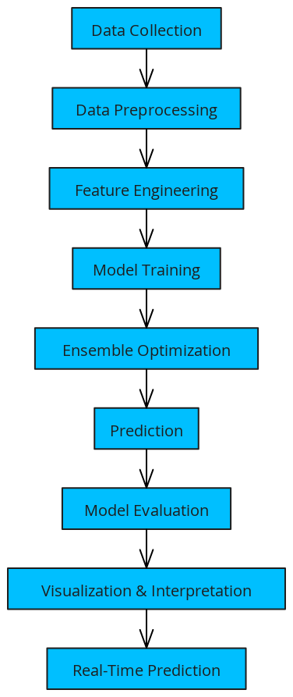
METHODLOGY

Slide 9
Year | Title | Author(s) | Algorithms Used | Goal | Results
2024 | A Comparative Study of Loan Approval Prediction Using Machine Learning Methods | Vahid Sinap | Random Forest, Decision Trees, SVM, Logistic Regression | Compare performance of various algorithms for loan approval prediction | Highlights accuracy improvements in predicting loan approvals through model comparison and analysis
2019 | Modified Average of the Base-Level Models in the Hill-Climbing Bagged Ensemble Selection Algorithm for Credit Scoring | Tri Handhikaa, Achmad Fahrurozi, Revaldo Ilfestra Metzi Zen, Dewi Putrie Lestari, Ilmiyati Sari, Murnia | Hill-Climbing Bagged Ensemble Selection, Base-Level Models | Enhance credit scoring through optimization of model selection using a modified averaging approach | Improves credit scoring accuracy by optimizing model weights via hill climbing, yielding superior results compared to traditional methods
2023 | Loan approval prediction system using logistic regression and CIBIL score | E. Kadam, A. Gupta, S. Jagtap, I. Dubey, G. Tawde | Logistic Regression | Develop a loan approval prediction system utilizing logistic regression along with CIBIL scores | Combines logistic regression with CIBIL scores to predict loan approvals effectively, demonstrating high accuracy in predicting loan outcomes

Slide 10
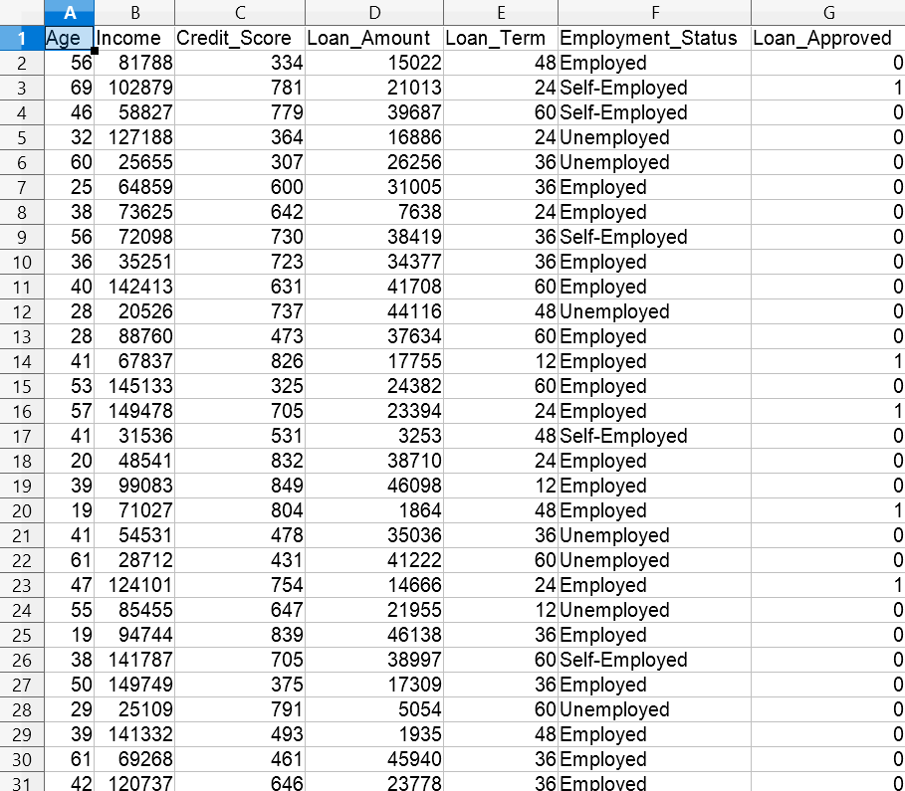
DATASETS
Dataset Overview:
• Source: Kaggle Loan Approval Prediction Dataset
• Size: Contains multiple thousand records, offering a substantial amount of data for training and validation.
• Format: The dataset is provided as a CSV file containing 11 feature columns and 1 target variable.
• Target Variable: loan_status (binary classification: approved = 1, not approved = 0).

Slide 11
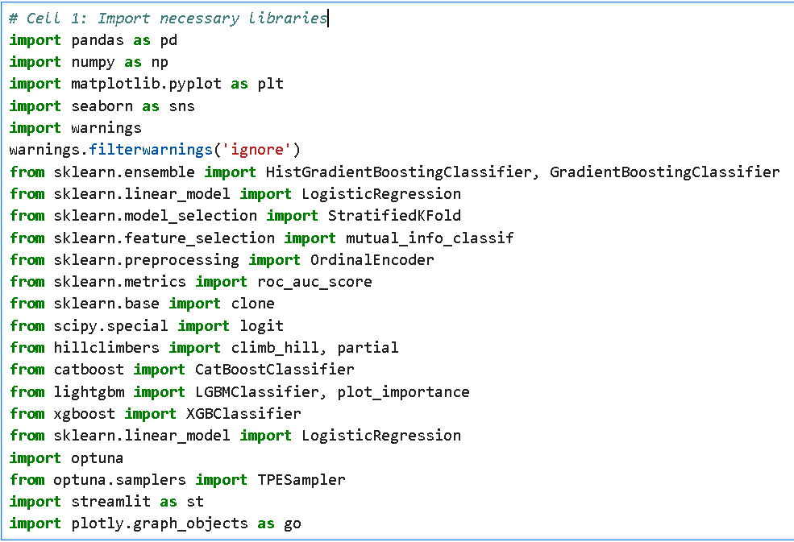
Import Package

Slide 12
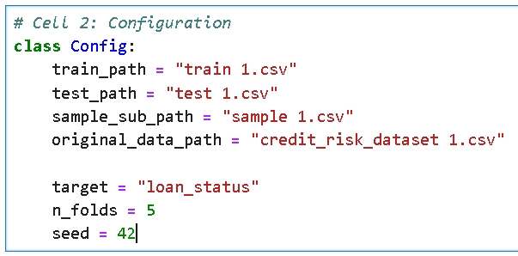
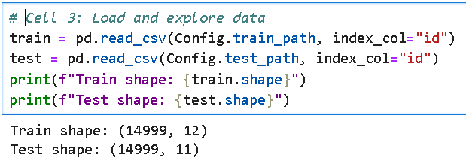
Load csv file
Exploratory Data Analysis

Slide 13
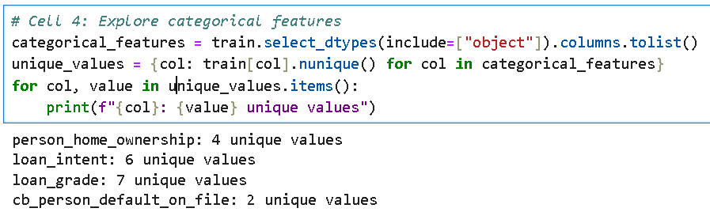

Slide 14
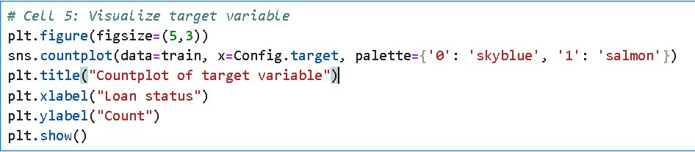
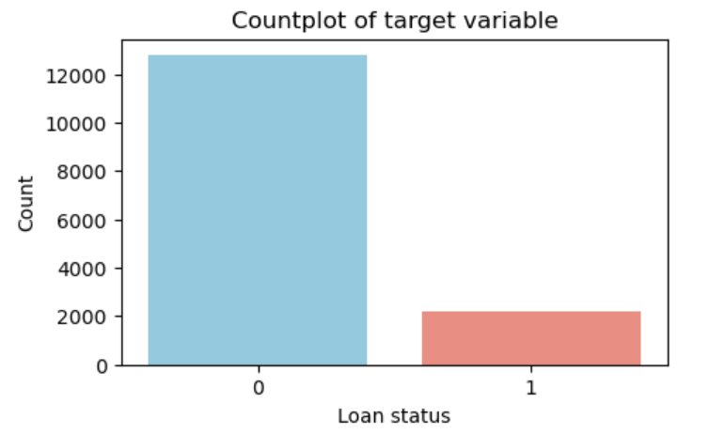

Slide 15
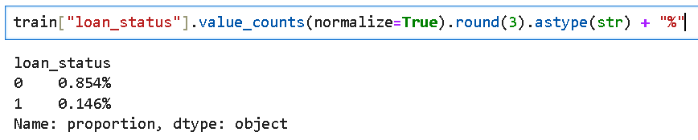
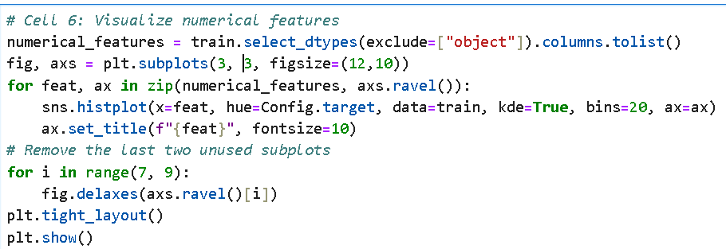
Histogram Diagram

Slide 16
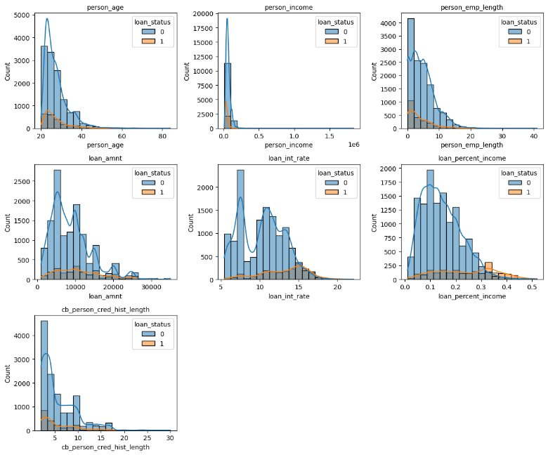

Slide 17
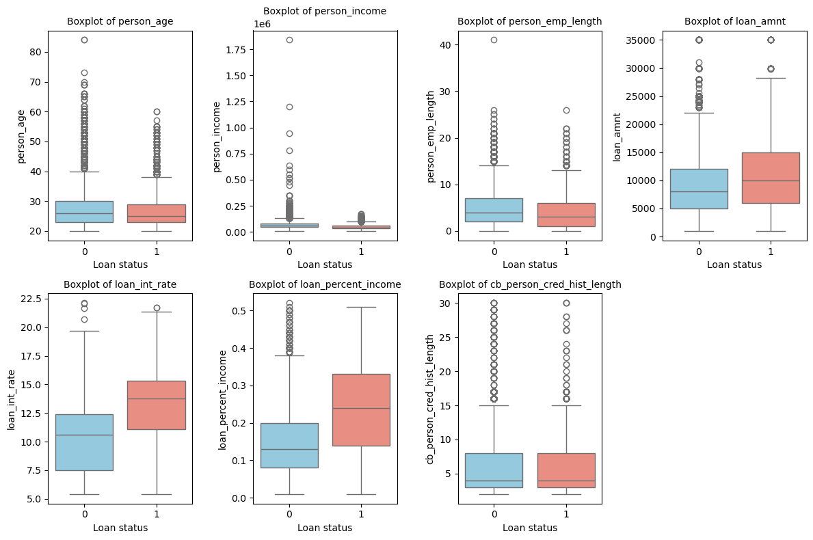
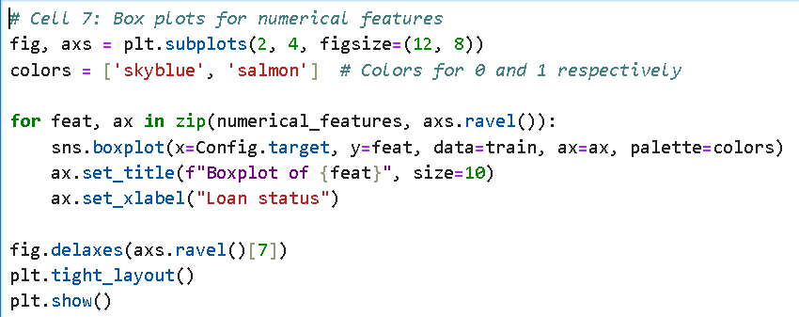
Box plot

Slide 18
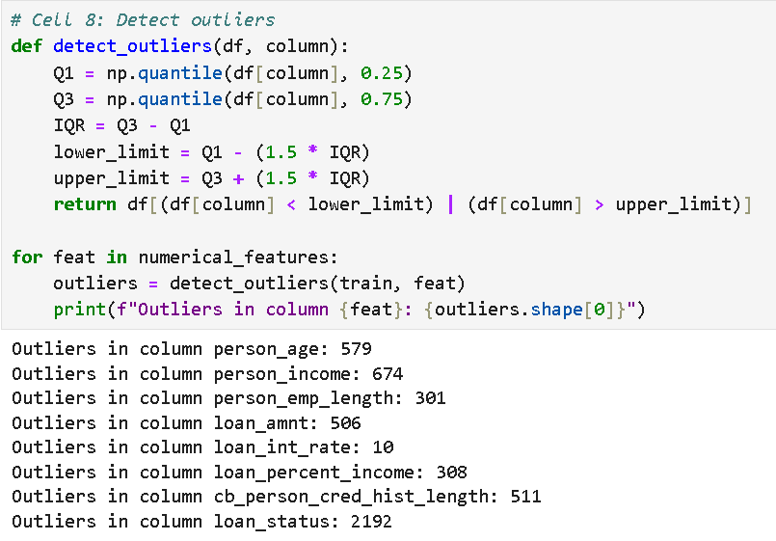
Outliers

Slide 19
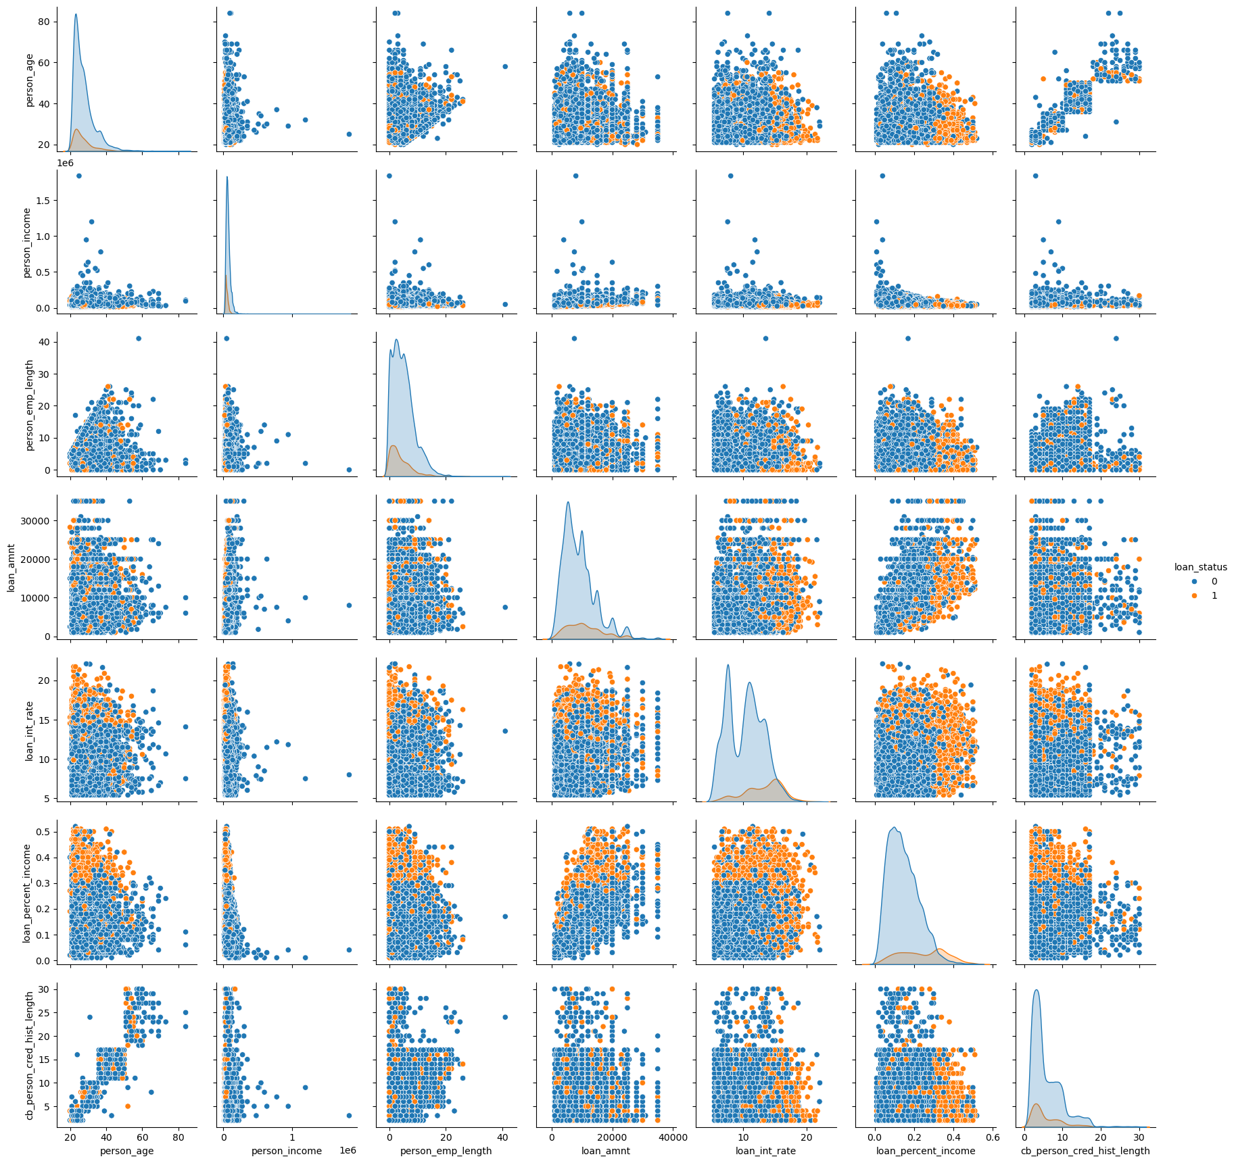
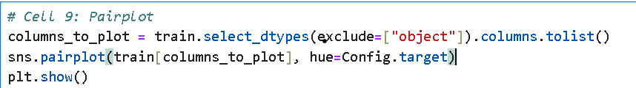
Pair Plot

Slide 20
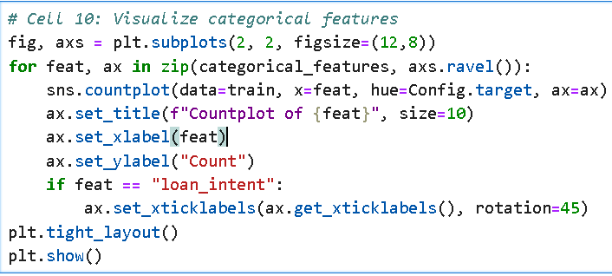

Slide 21
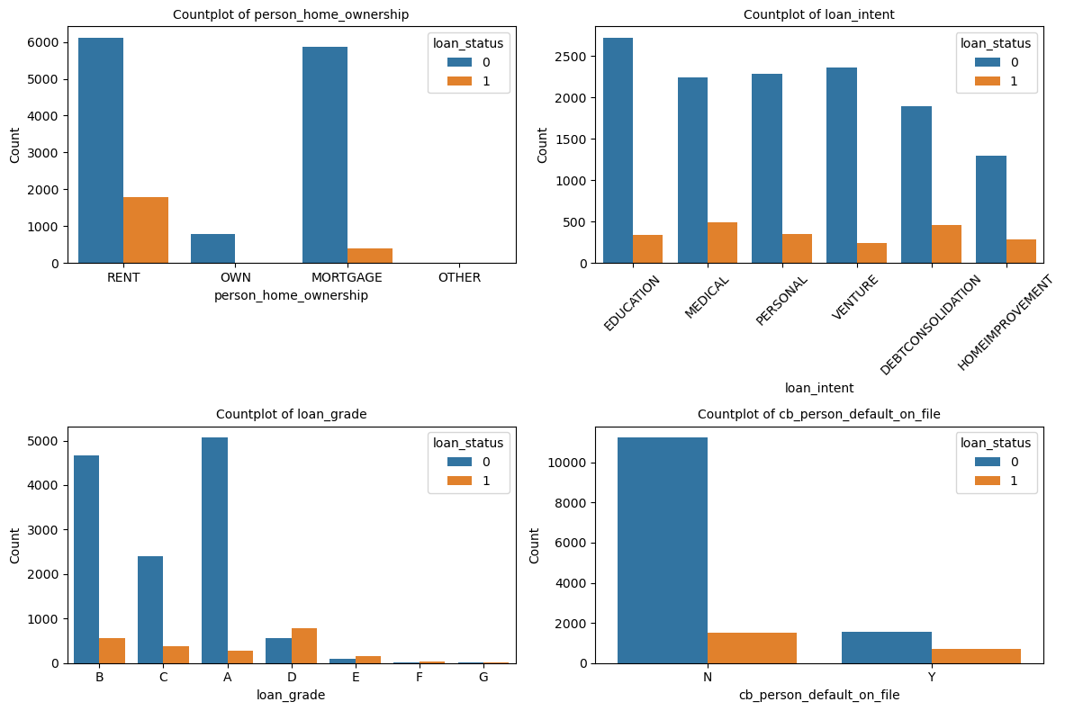

Slide 22
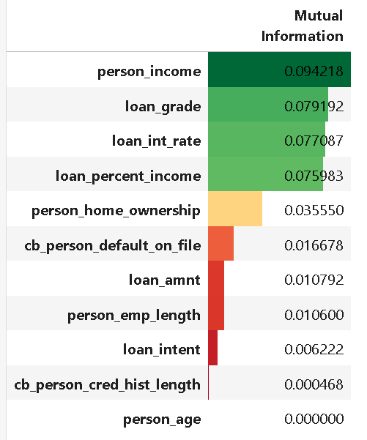
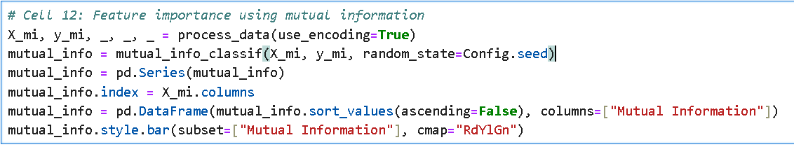
Heatmap Visualization

Slide 23
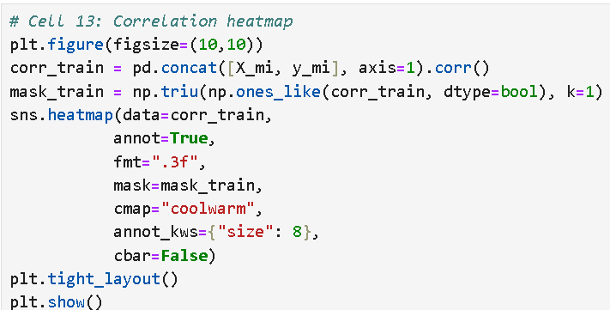

Slide 24
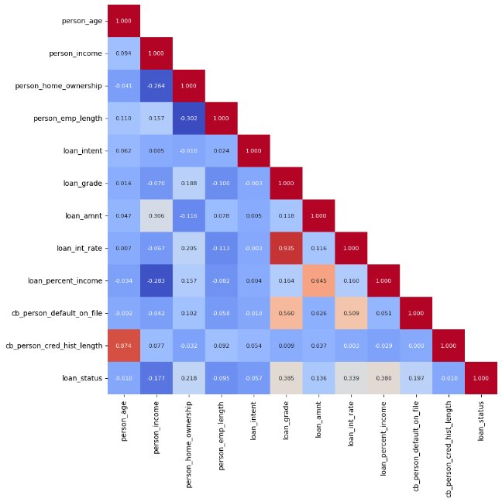

Slide 25
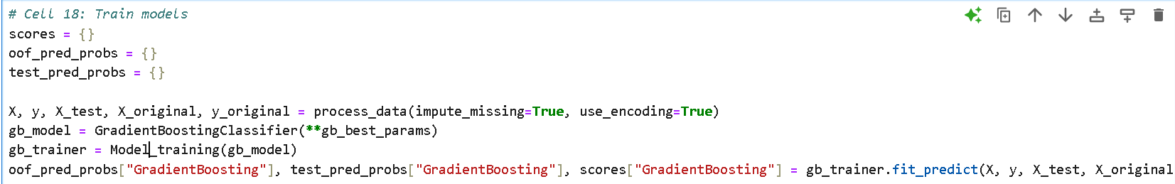
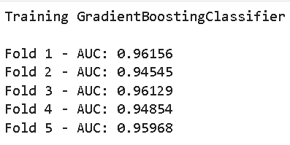
Model Train
Gradient Boosting Classifier

Slide 26
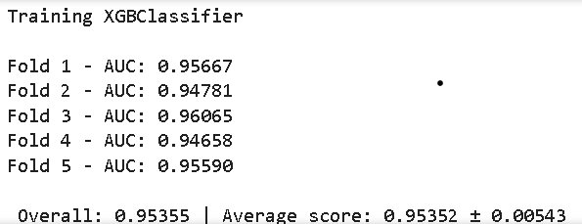
XGBoosting Classifier

Slide 27
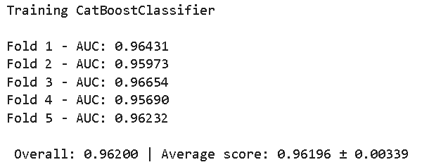
CatBoost Classifier

Slide 28
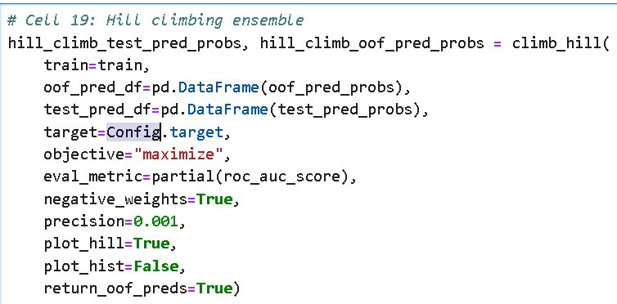
Hill Climbing Ensemble

Slide 29
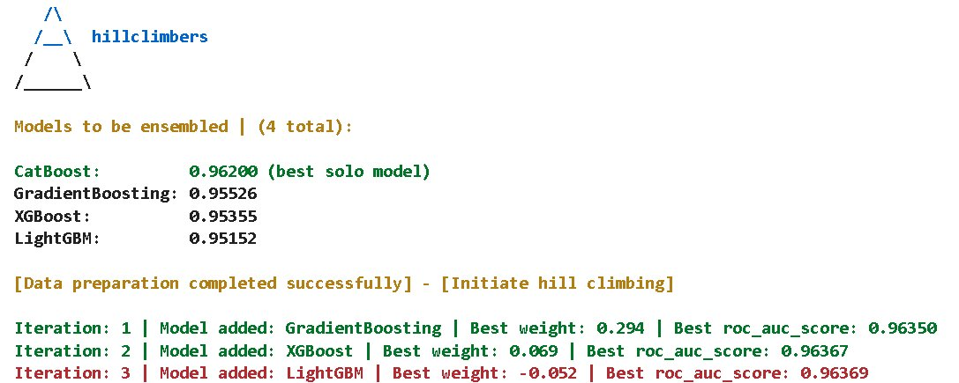

Slide 30
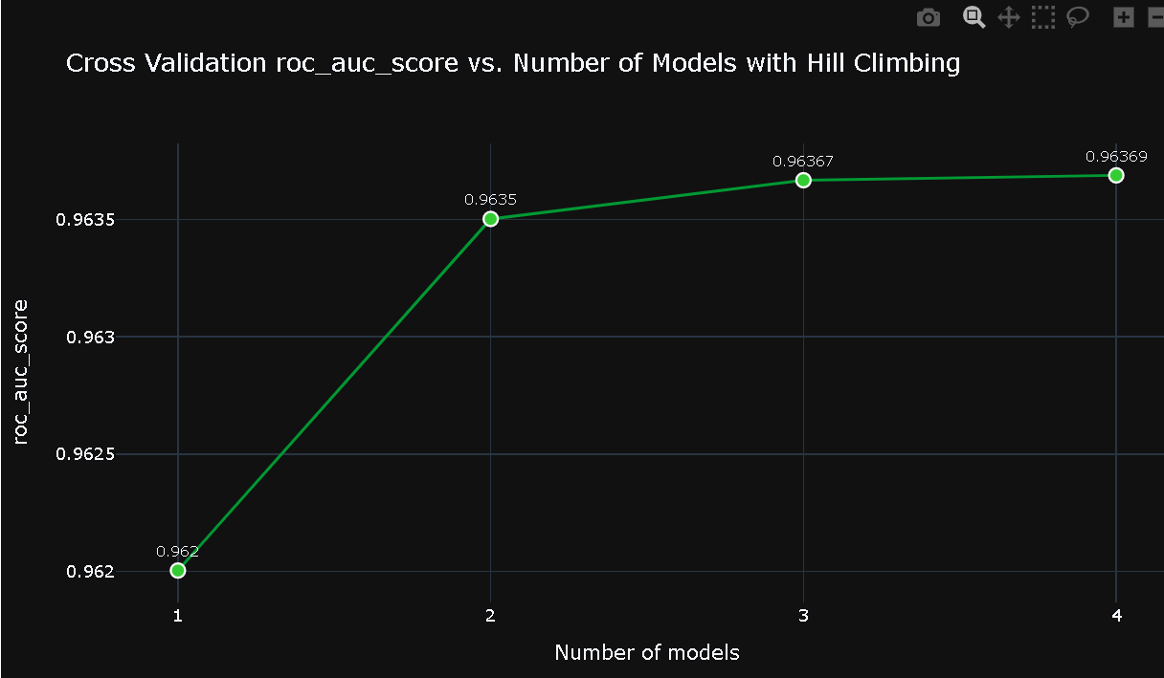
Roc_Auc_Score

Slide 31
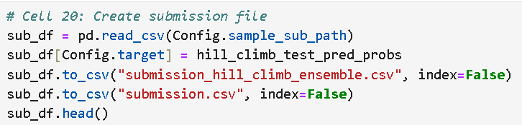
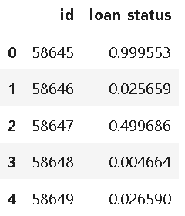
Create Submission File

Slide 32
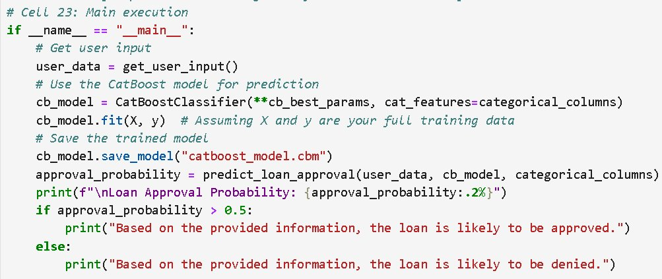
Main Execution

Slide 33
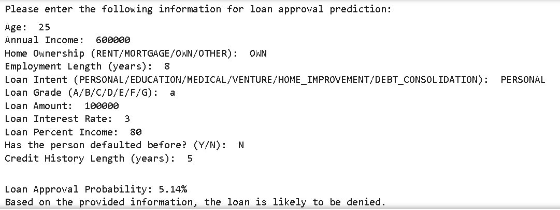

Slide 34
CONCLUSION
machine learning techniques for loan prediction using various classification models, including Gradient Boosting, Logistic Regression, CatBoost, LightGBM, and XGBoost. By leveraging feature engineering, ensemble learning, and hyperparameter optimization with Optuna, the study aims to improve predictive accuracy.

Slide 35
Thank you

